Slide 1
Investigating the Behaviour of Character-Level Recurrent Neural Networks
B.Sc. Thesis
Leonie Weißweiler, Daniela Gerz

Slide 2
How do Character-Level RNNs behave compared to Word-Level?
Best Case: they remember the words seen during training and generate some new sensible ones because they learn morphology
Middle Case: they only generate words seen during training and thus behave the same as Word-Level RNNs
Worst Case: they do not even generated whole correct words

Slide 3
Idea
For each language, collect the most data that we can
Generate text with RNN with smaller training data
Use this as reference to decide which generated words are actual words in the language

Slide 4
Experiment Setup
Reference data: polyglot Wikipedia, 39 languages, 1-10 GB per language
Training data: 50,000 chars for each language
Use Char-rnn-tensorflow package to generate 500,000 chars
Models tested: LSTM, RNN, NAS, (GRU)
Performance measures:
Correctness: percentage of generated words that are in the big corpus
Producivity: number of generated words that are se

Slide 5
Type-Token-Ratios

Slide 6
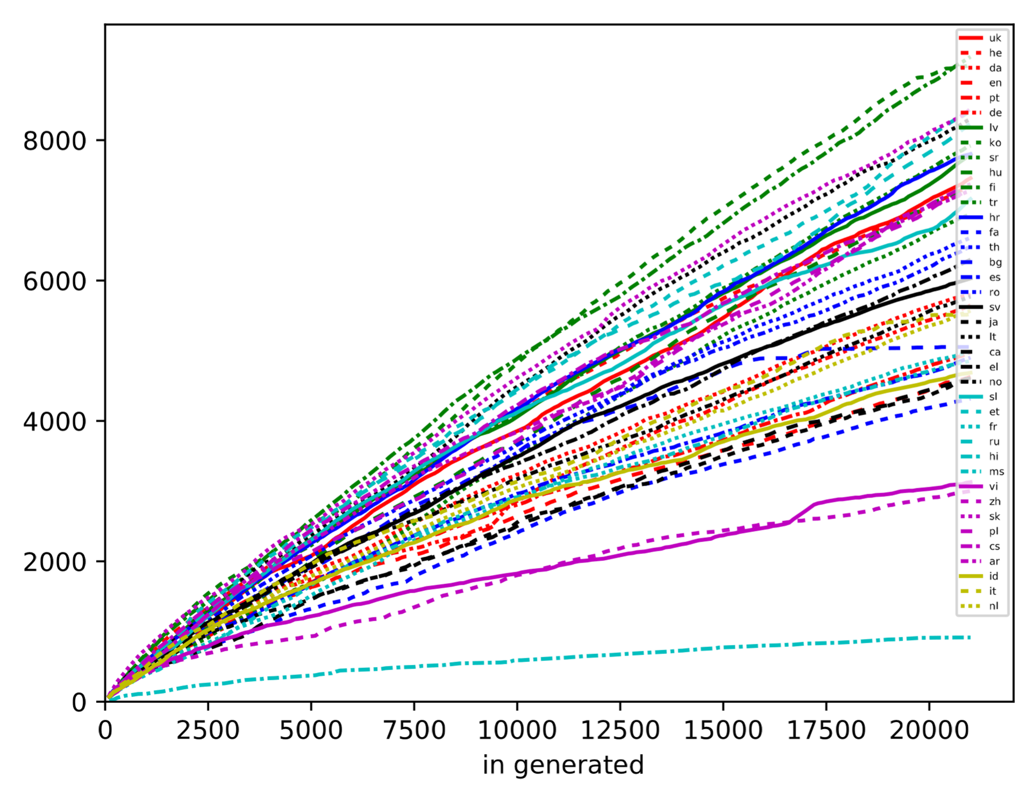
Number of types
Number of tokens

Slide 7
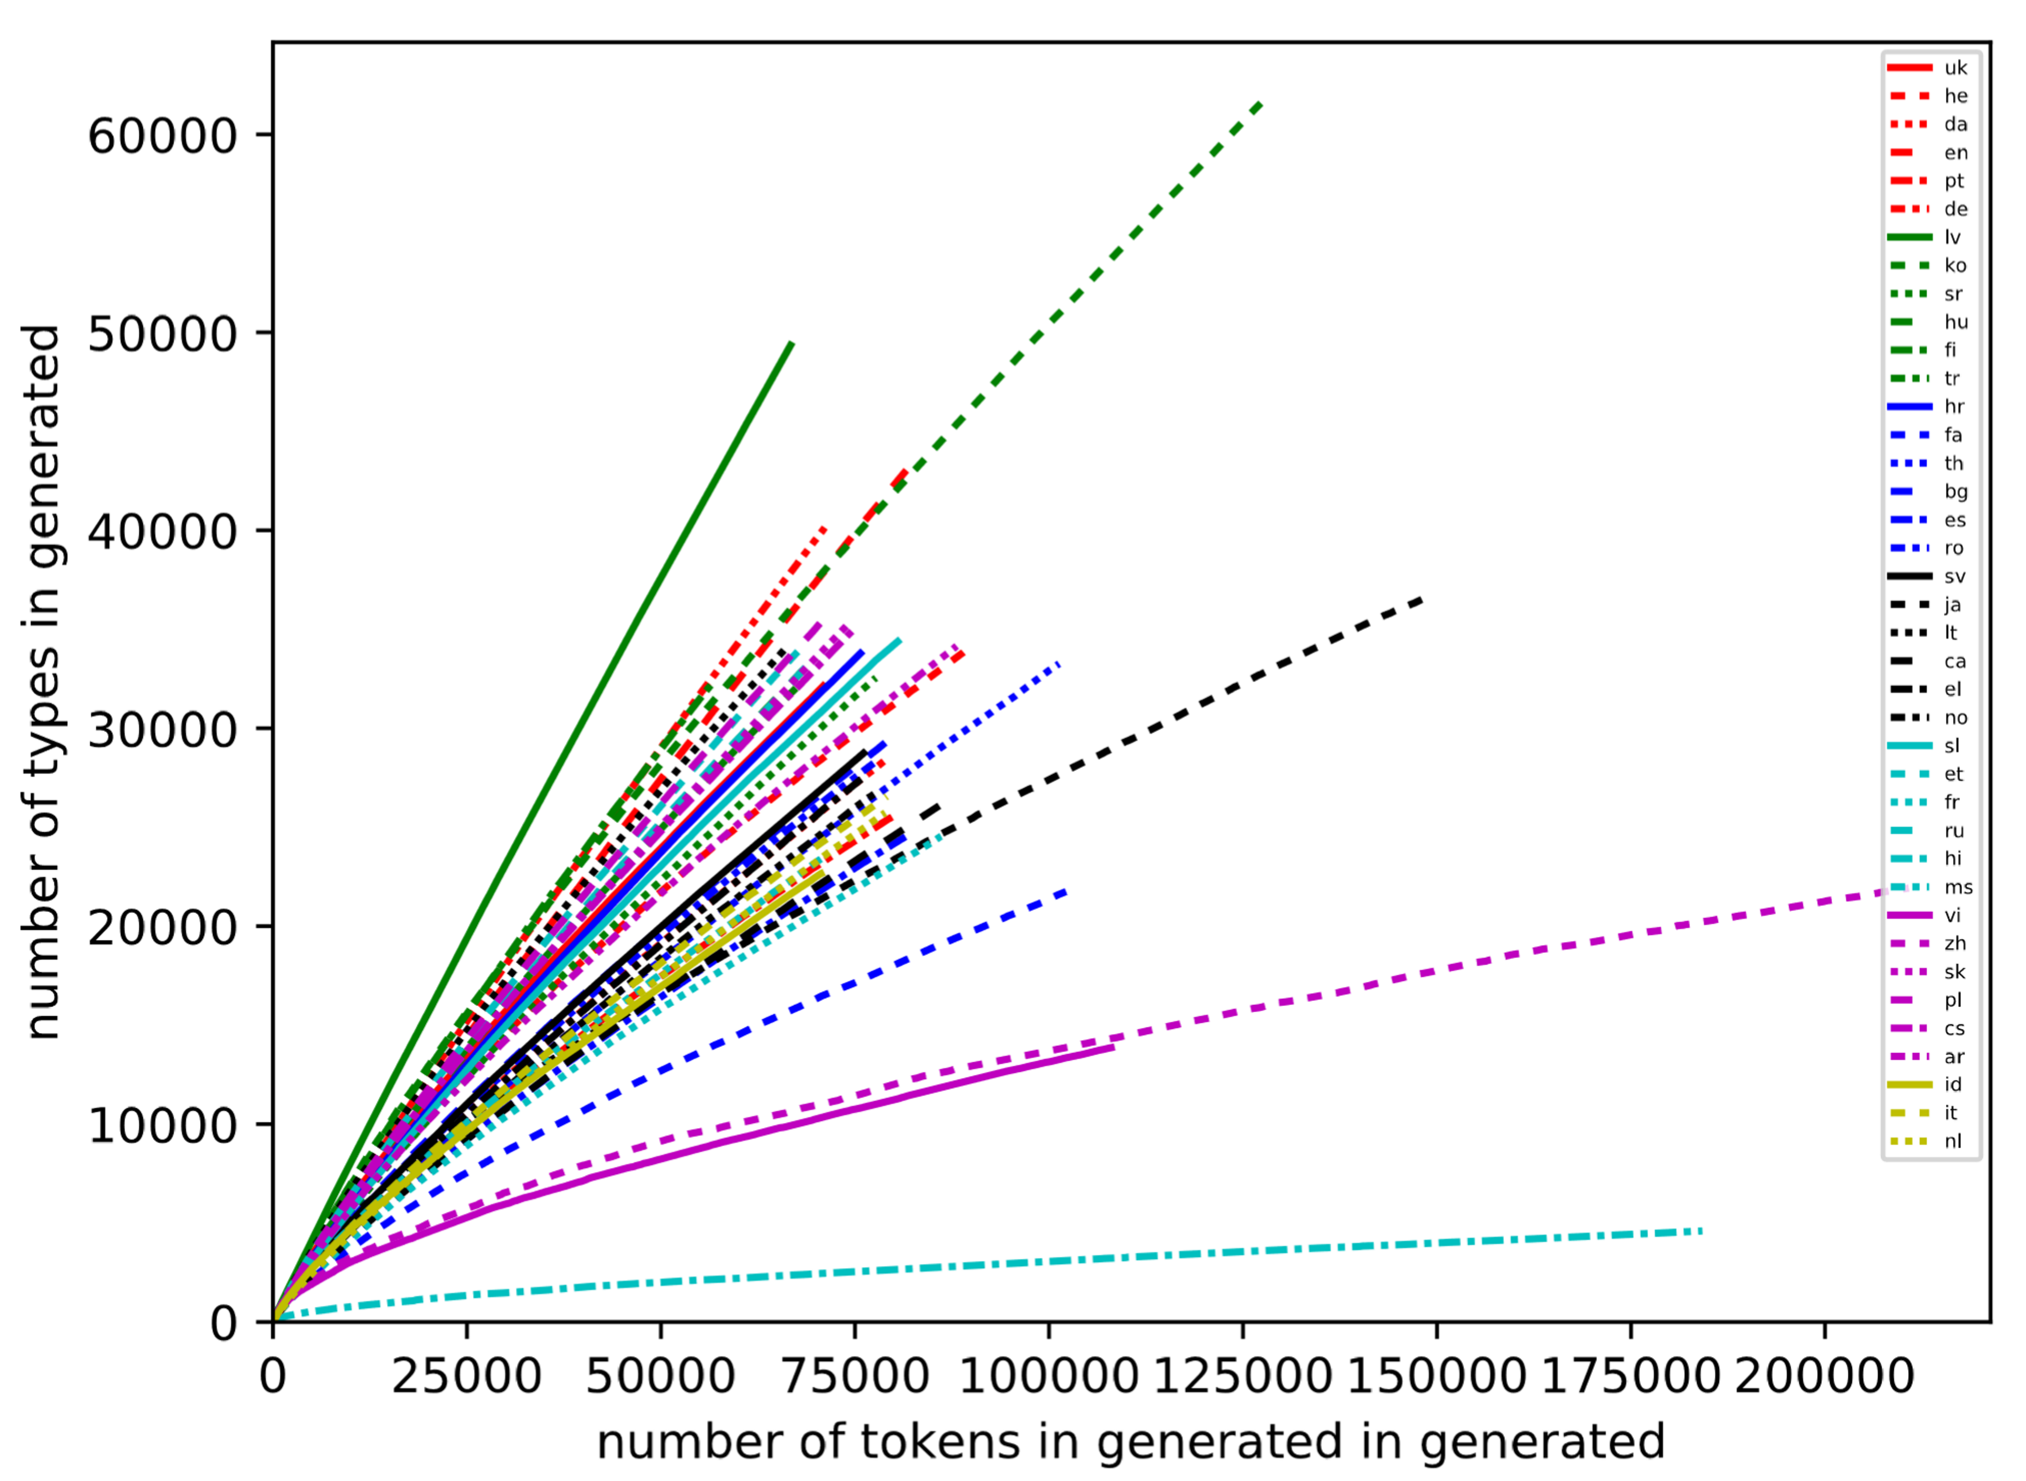

Slide 8
Selected Graphs for LSTM

Slide 9
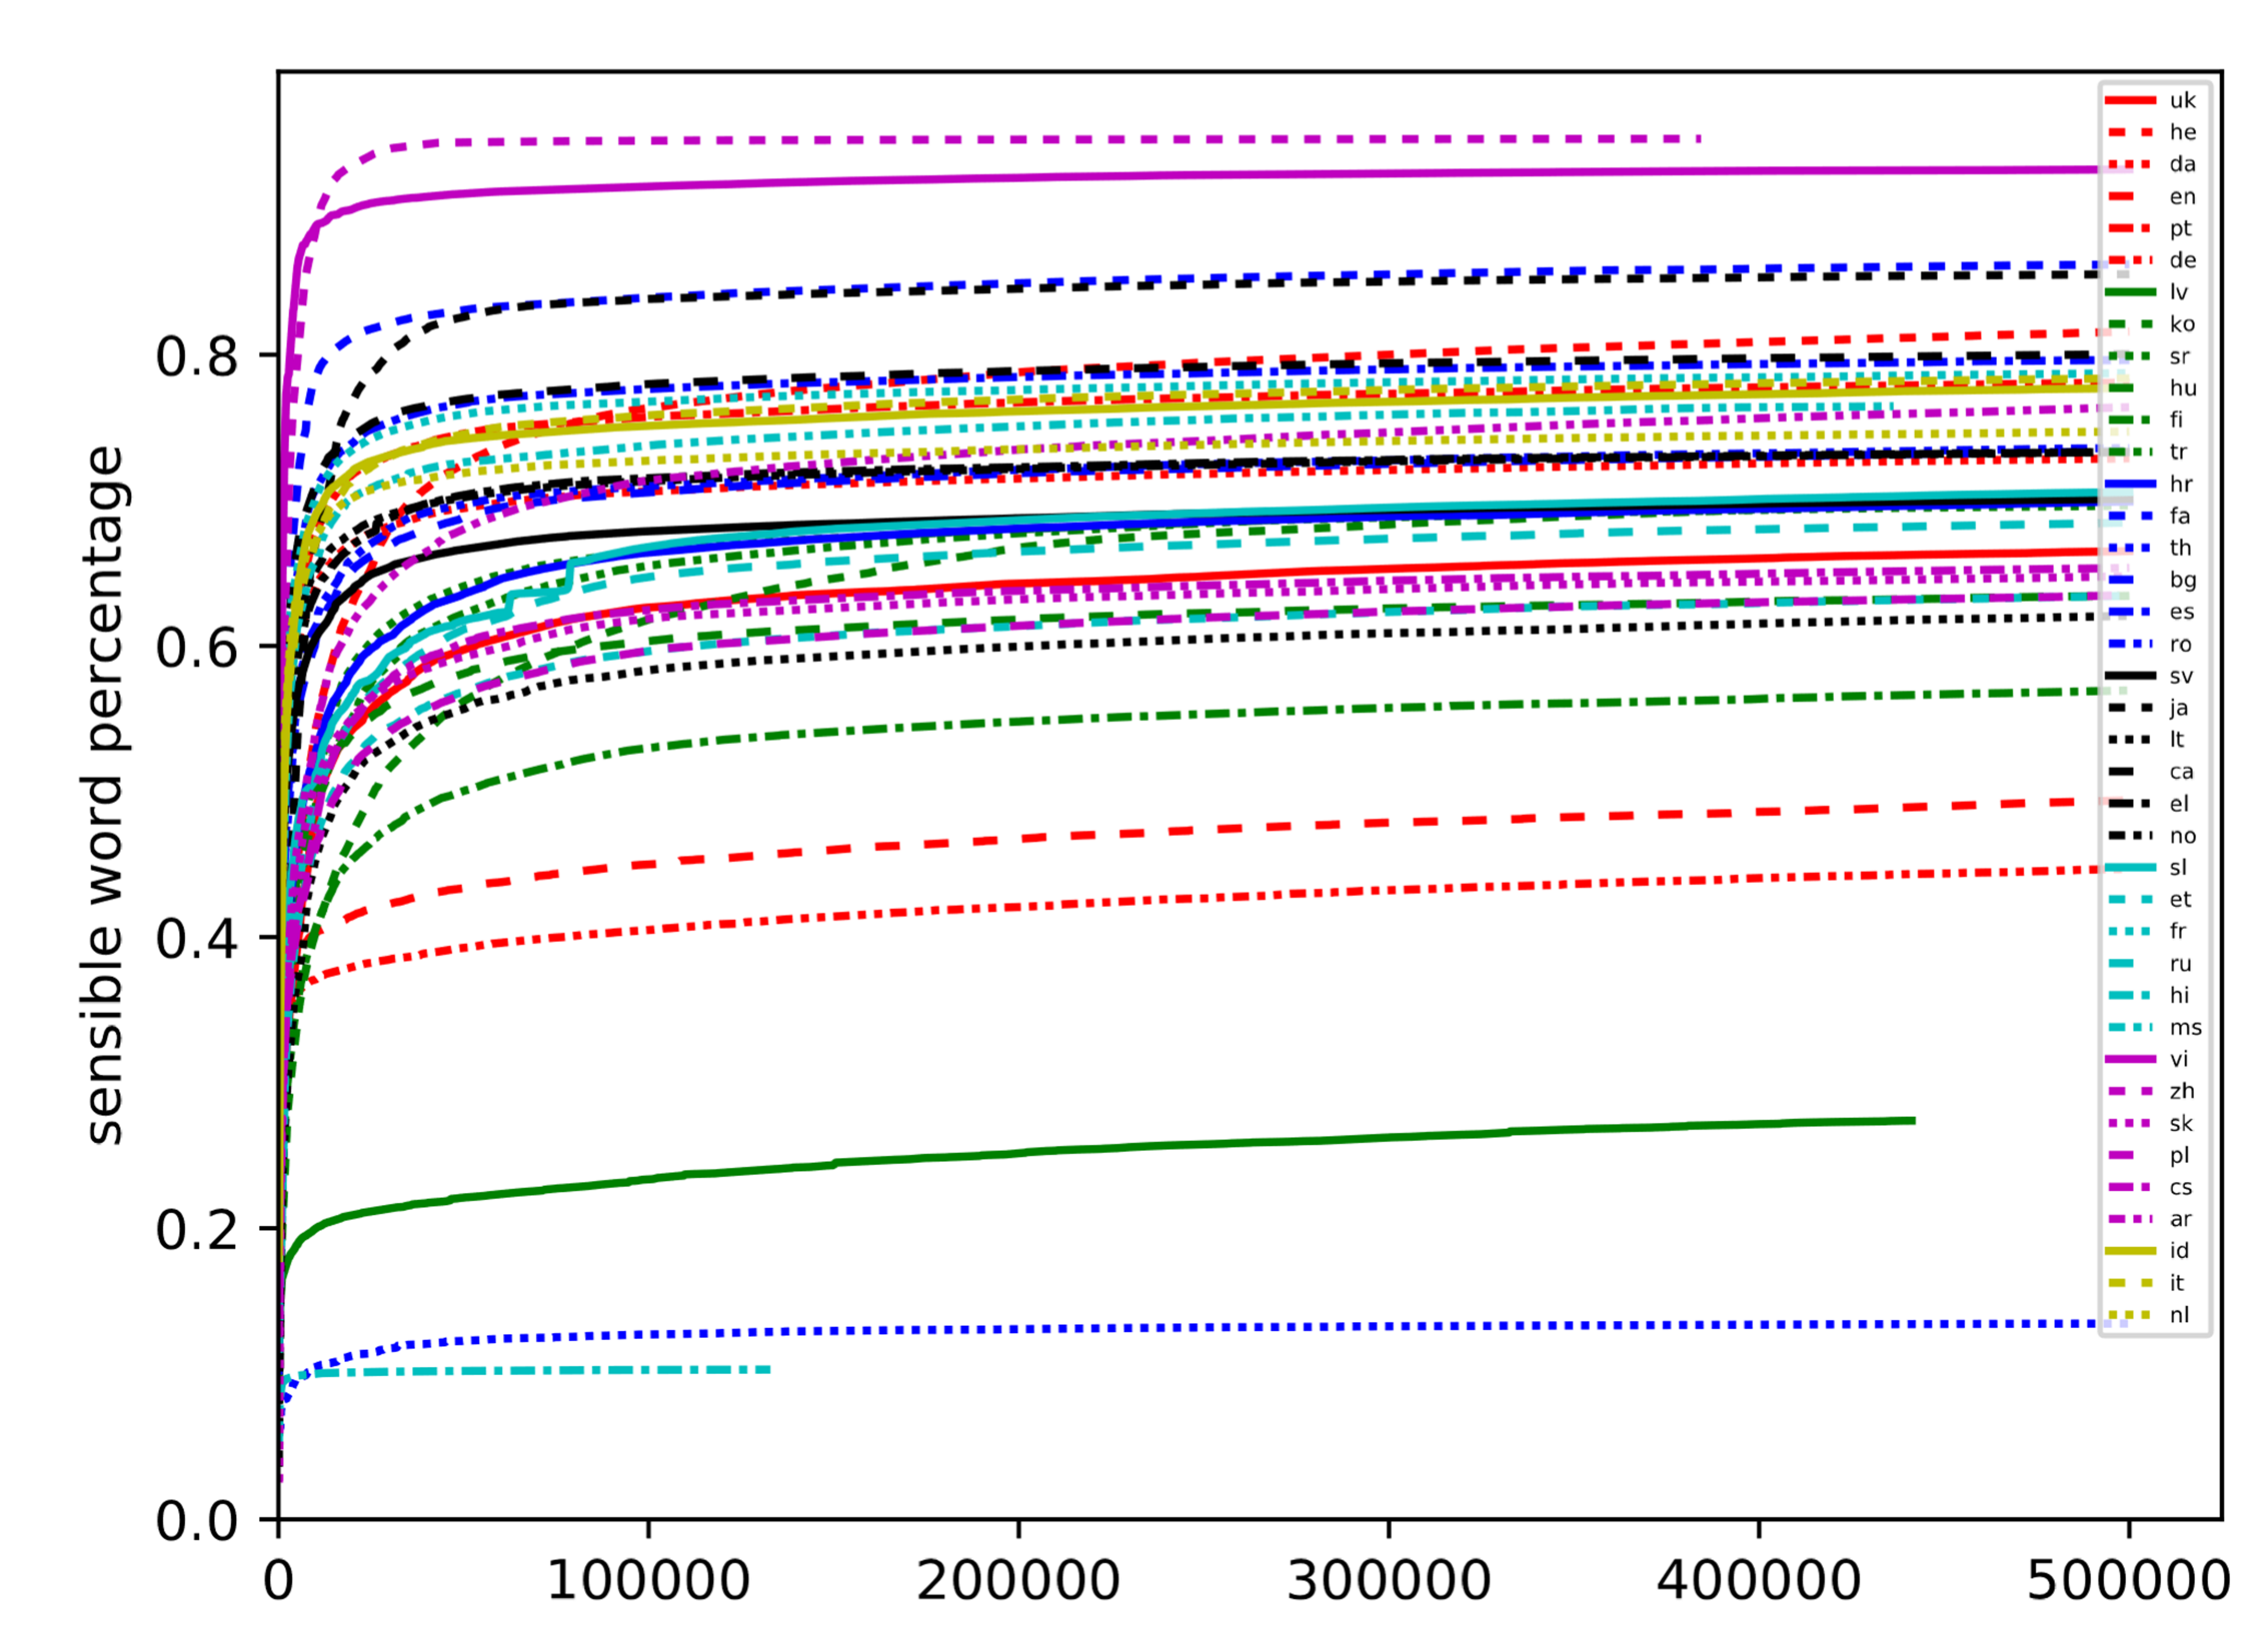
Number of types in huge

Slide 10
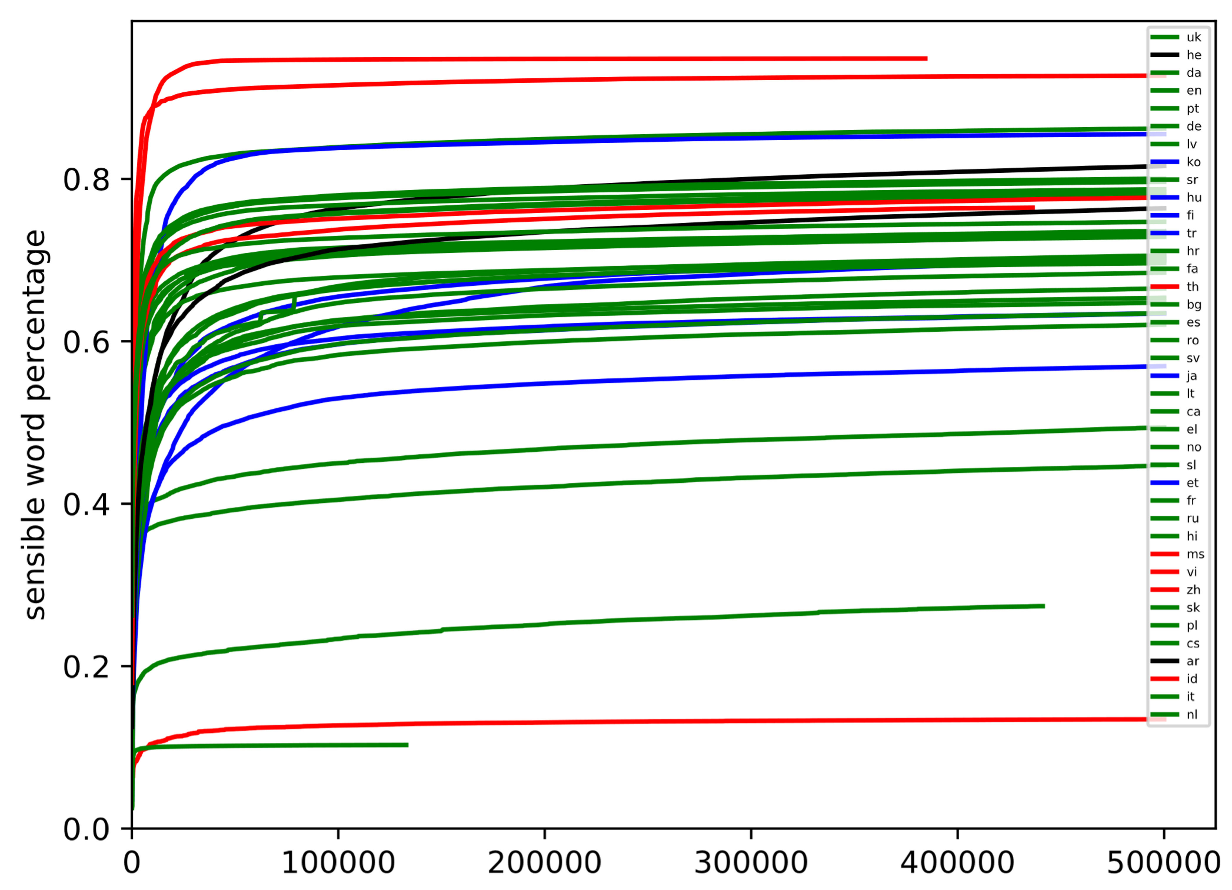
Number of types in huge (language families)

Slide 11
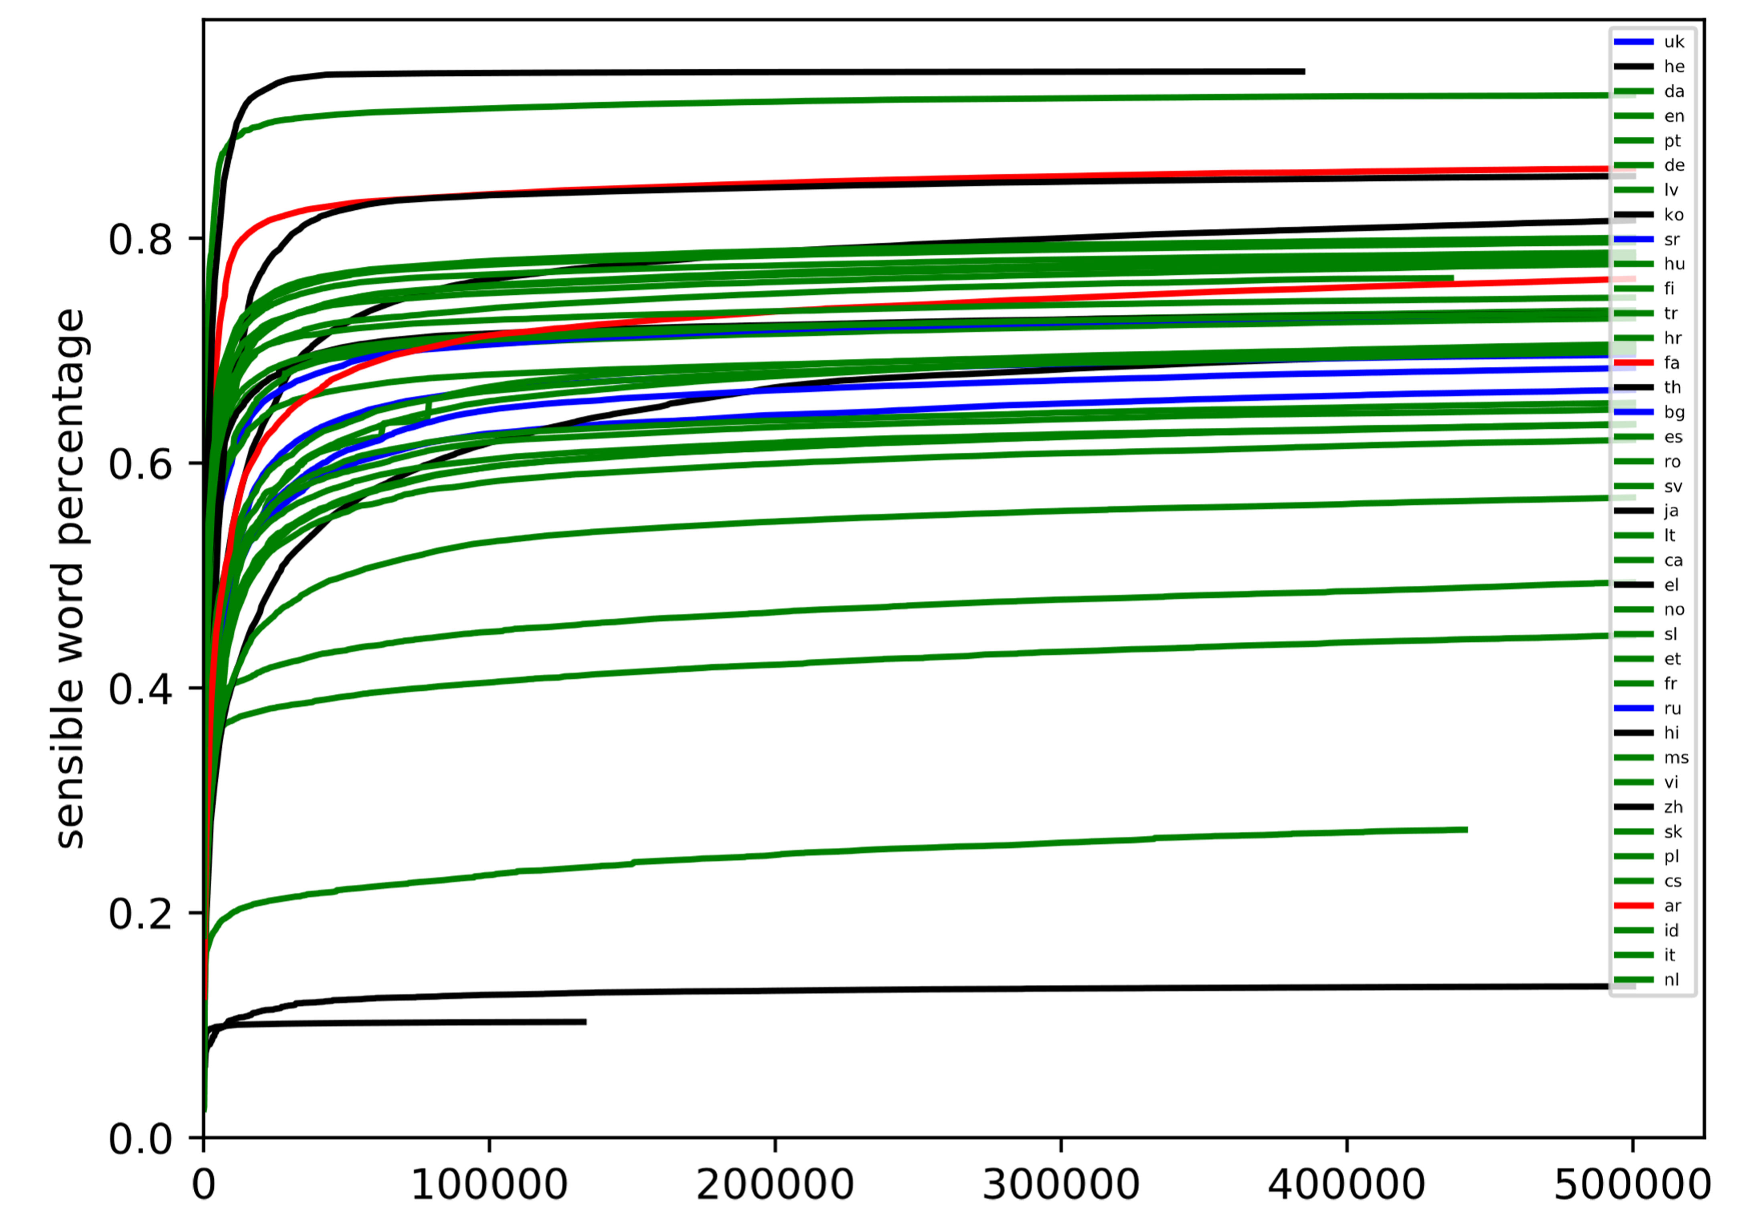
Number of types in huge (scripts)

Slide 12
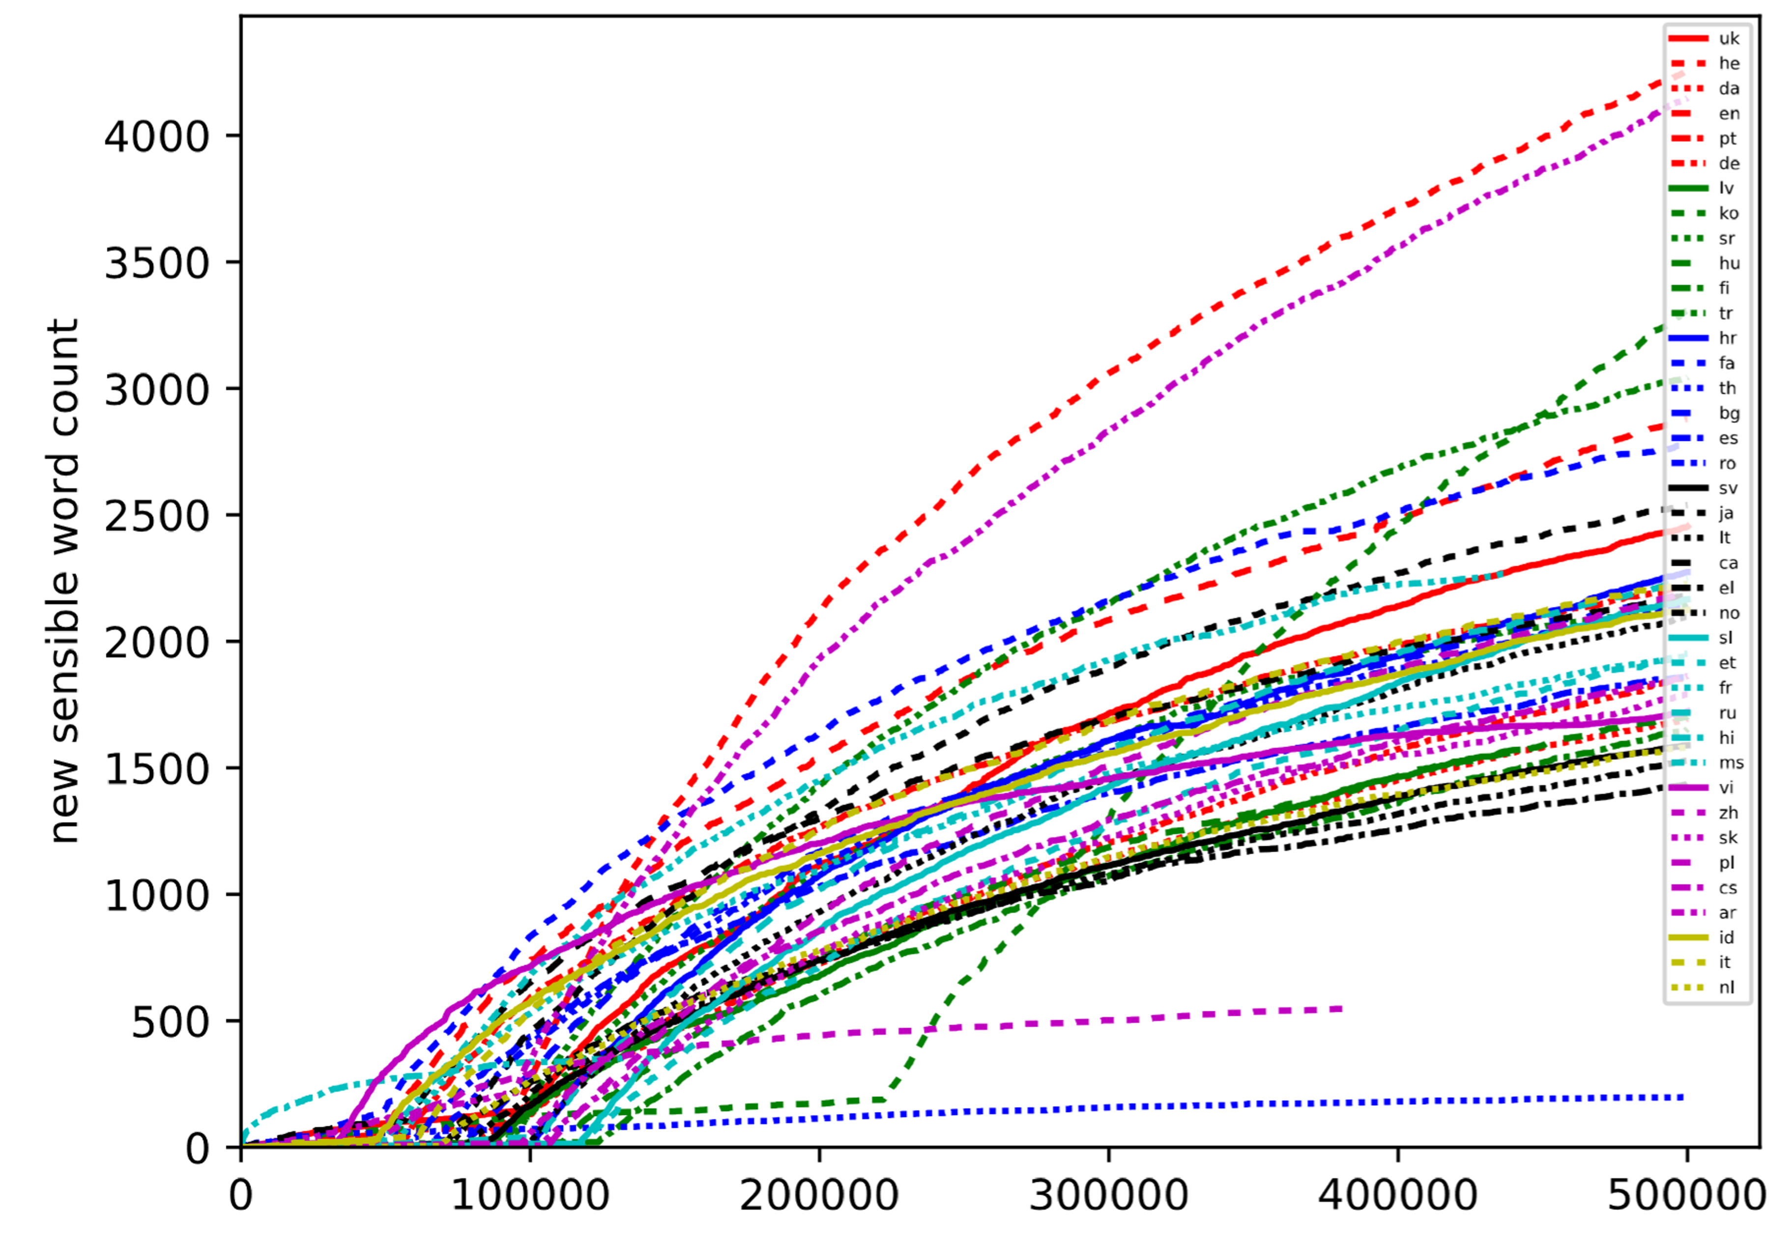
Number of types in huge

Slide 13
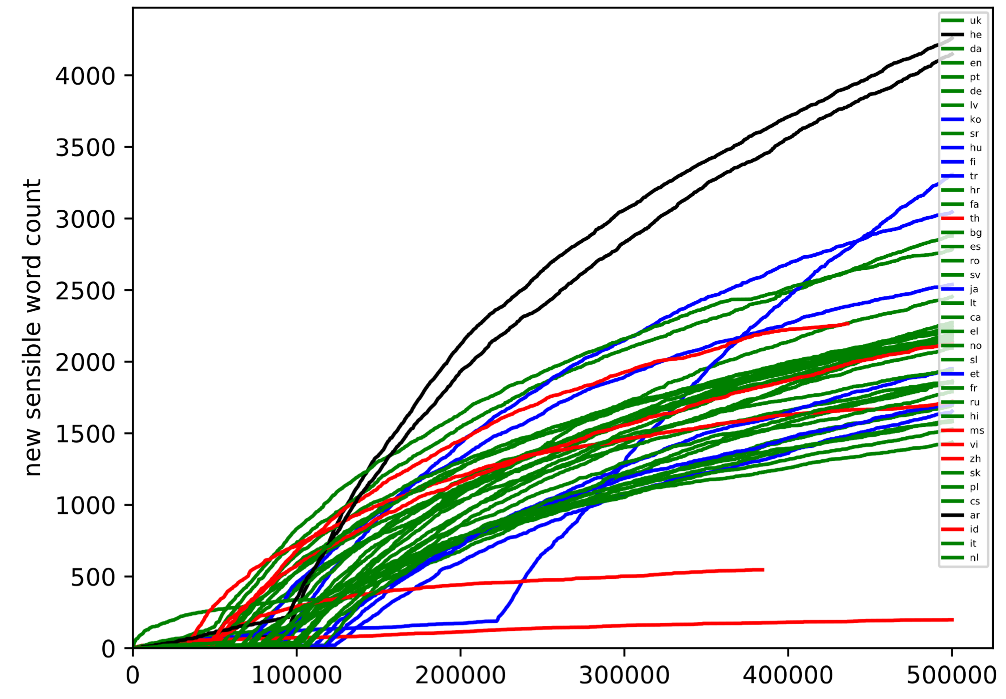
Number of types in huge (language families)

Slide 14
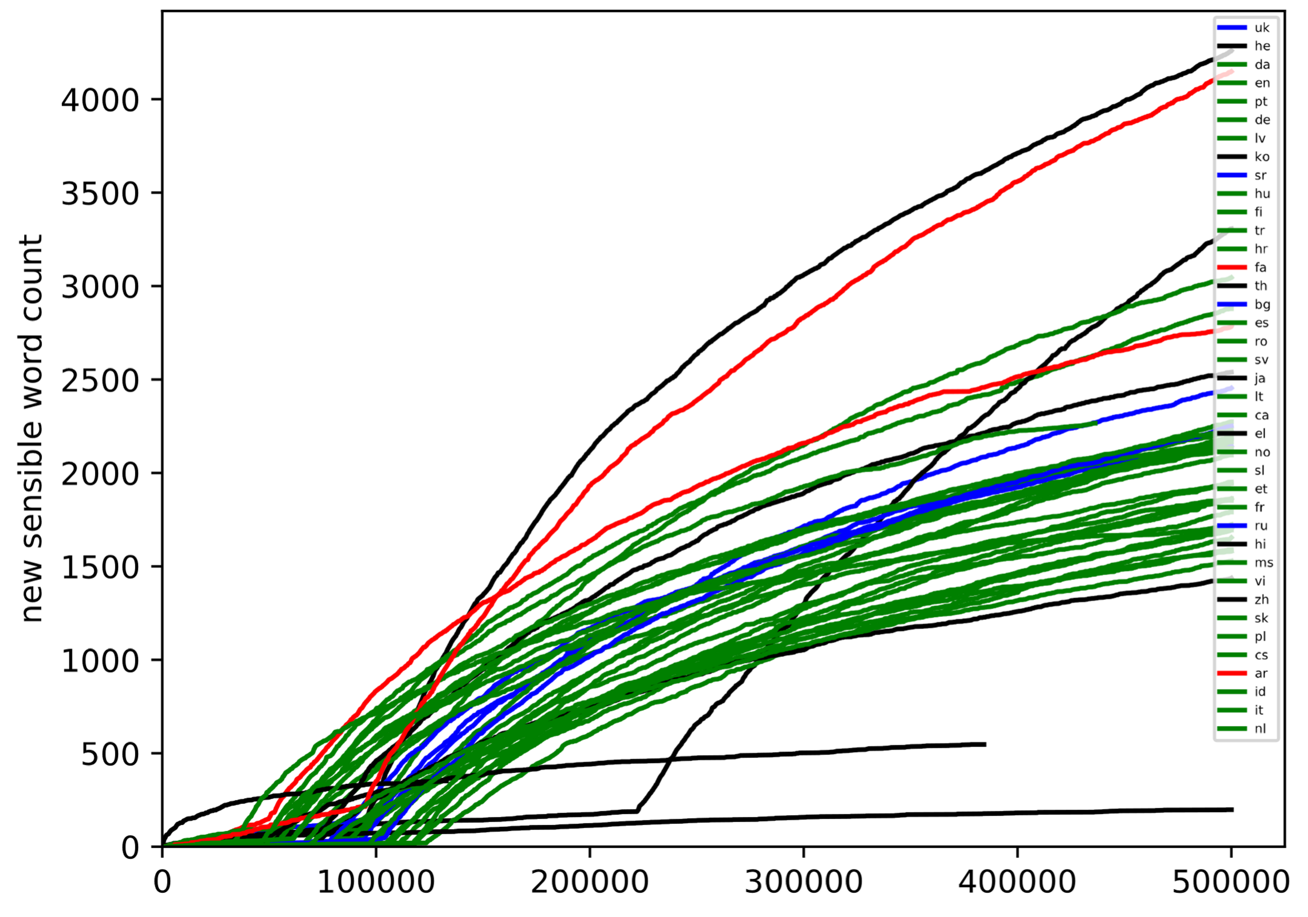
Number of types in huge (scripts)

Slide 15
Selected Languages

Slide 16
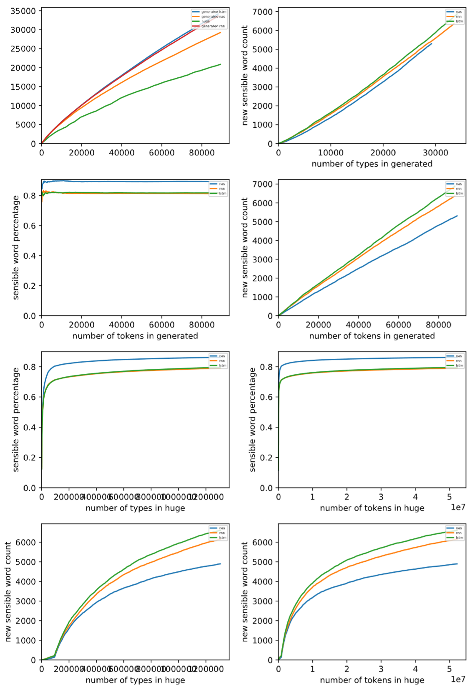
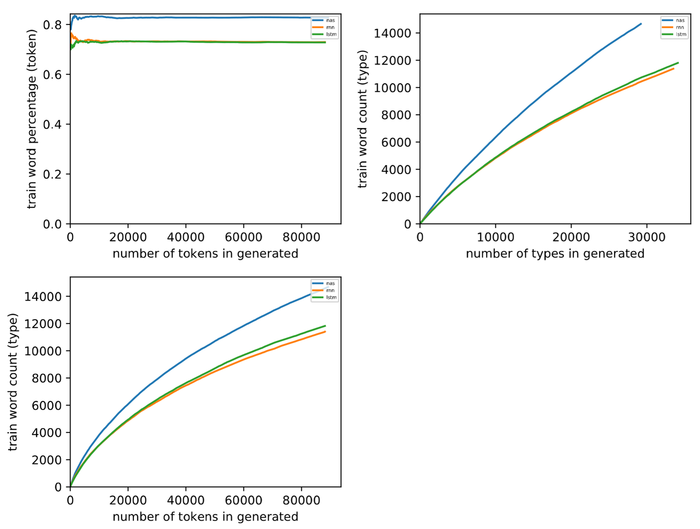
Arabic

Slide 17
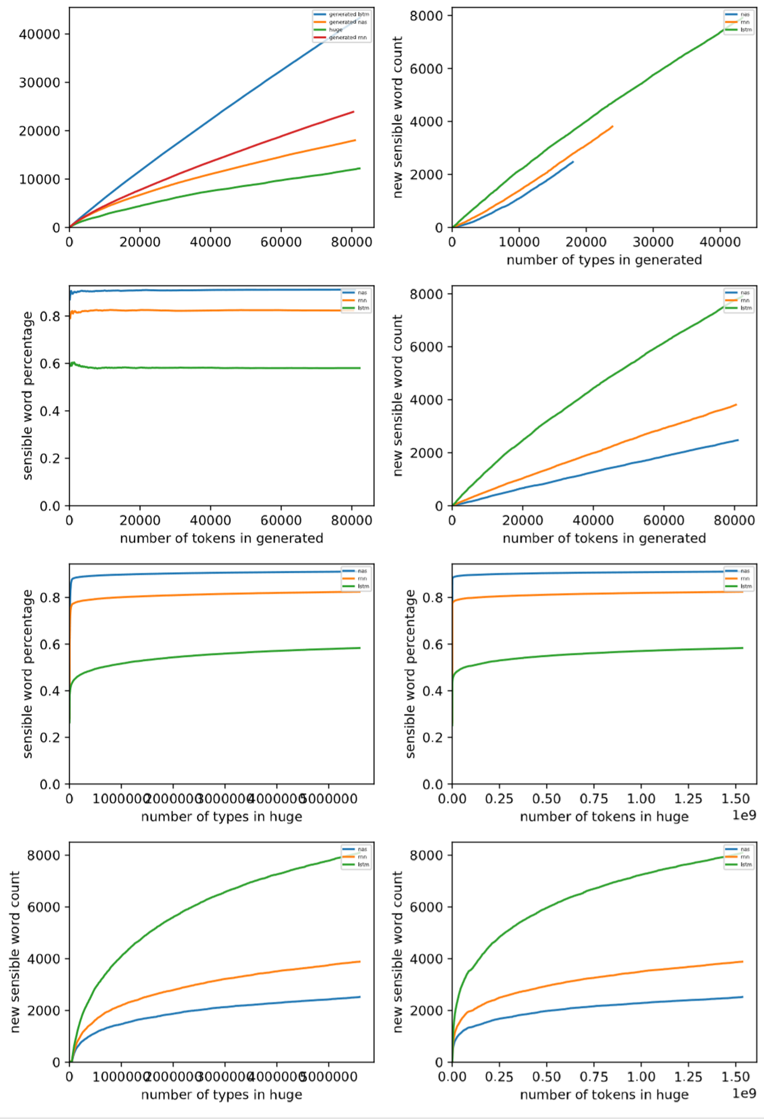
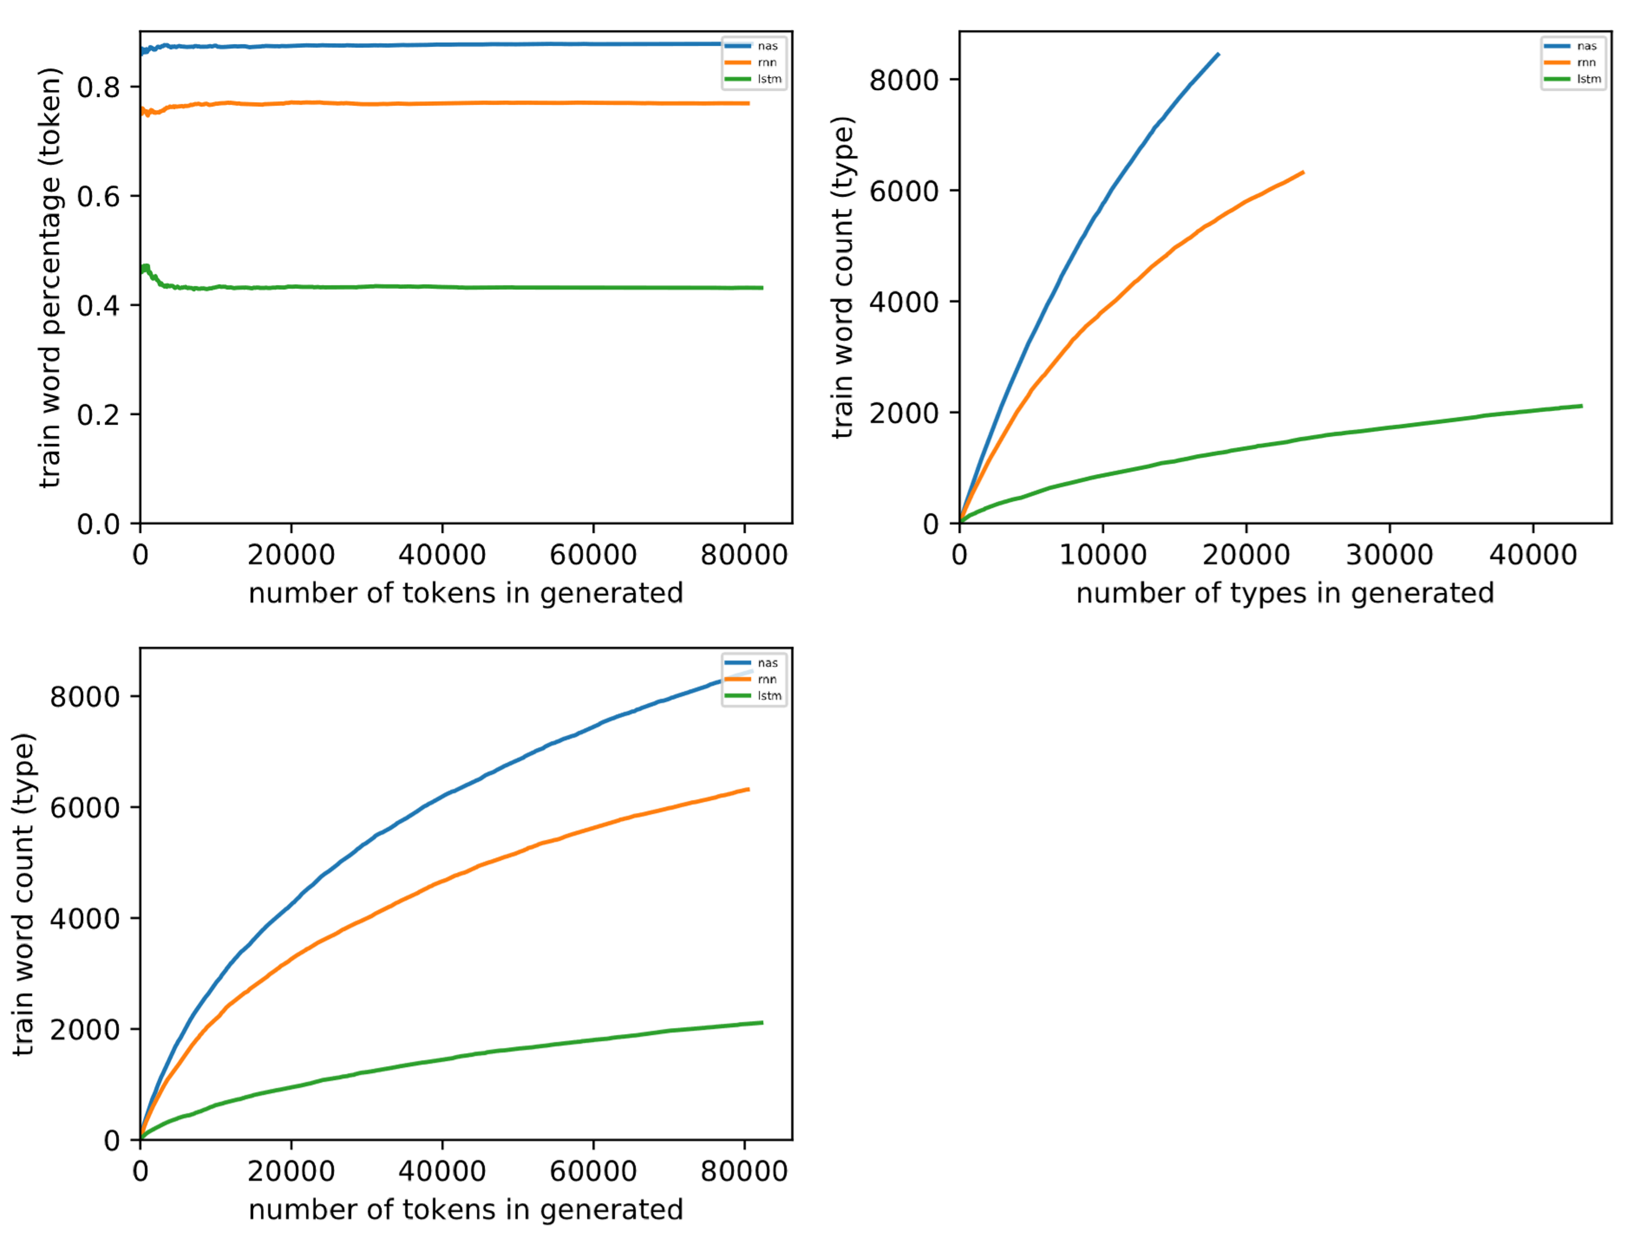
English

Slide 18
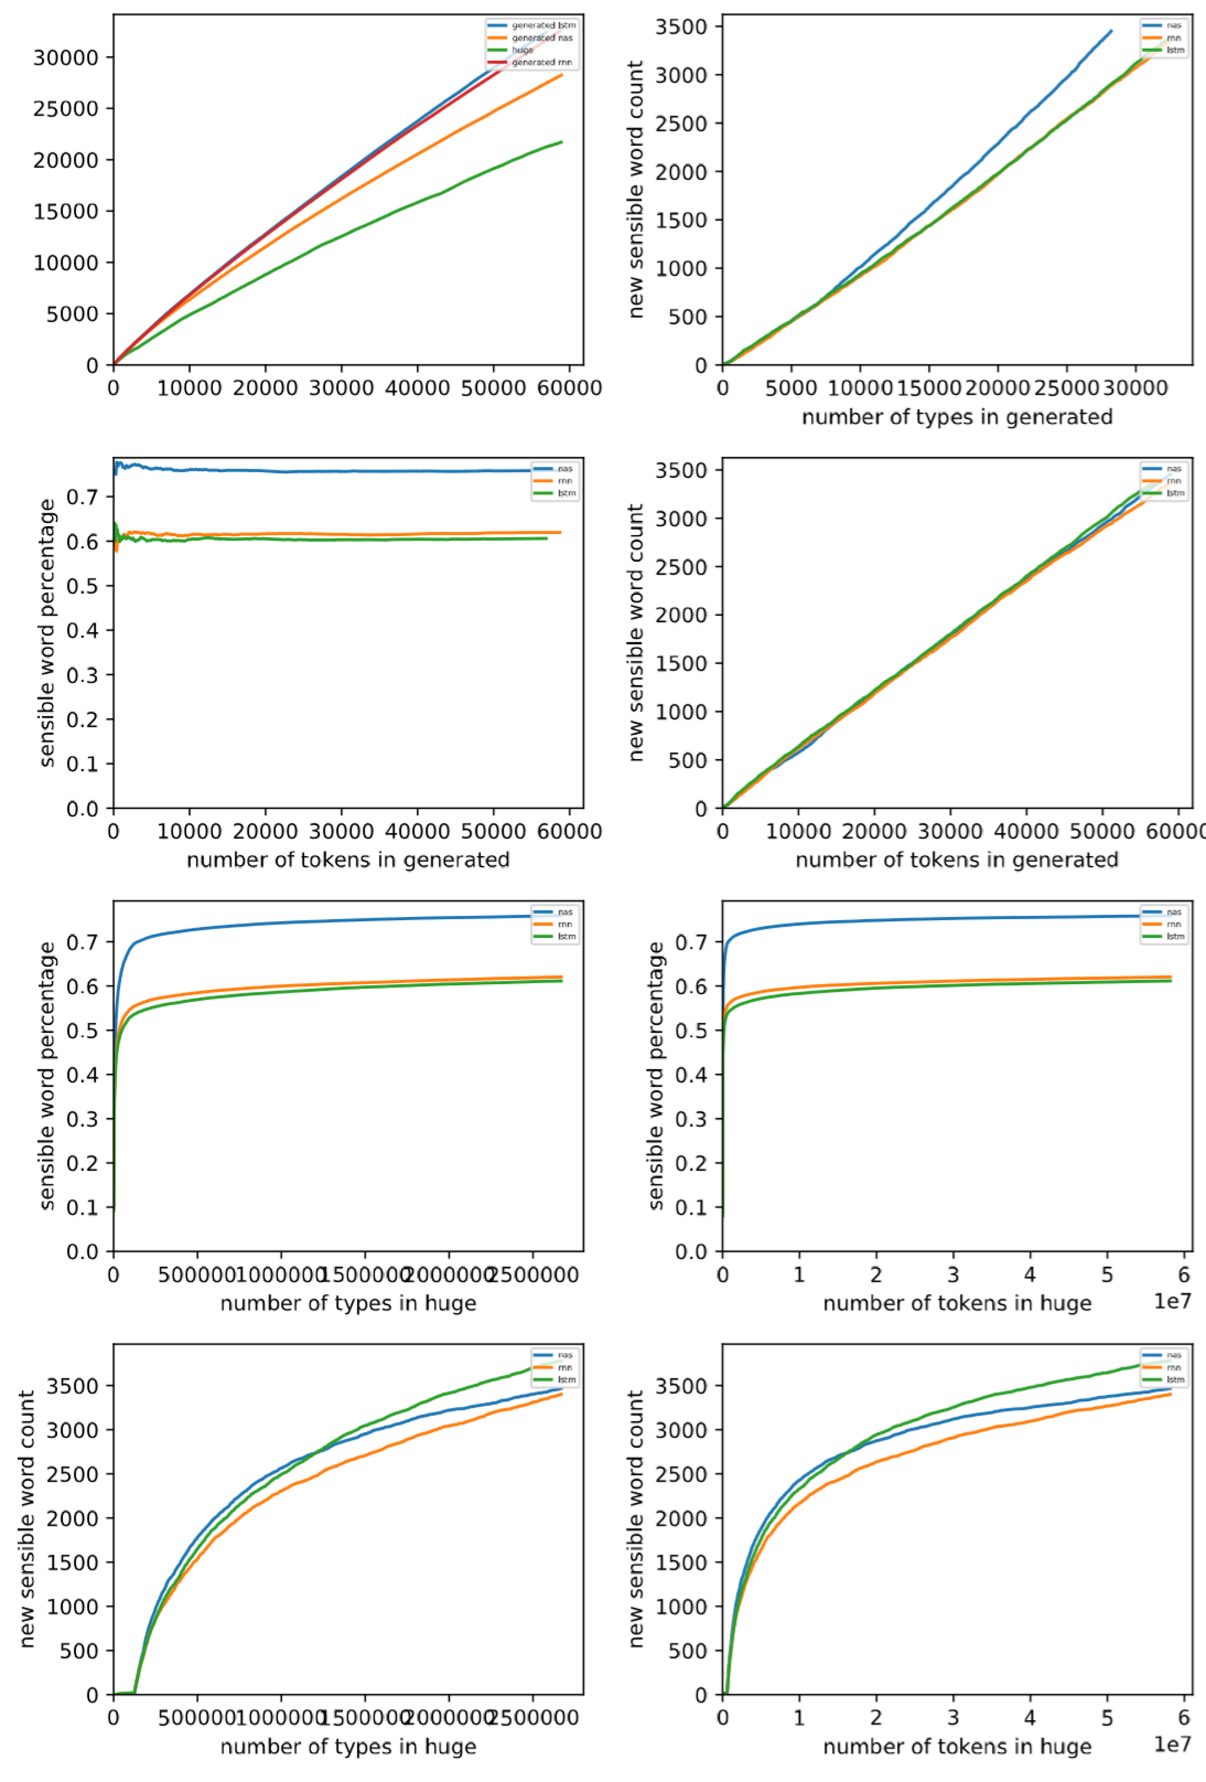
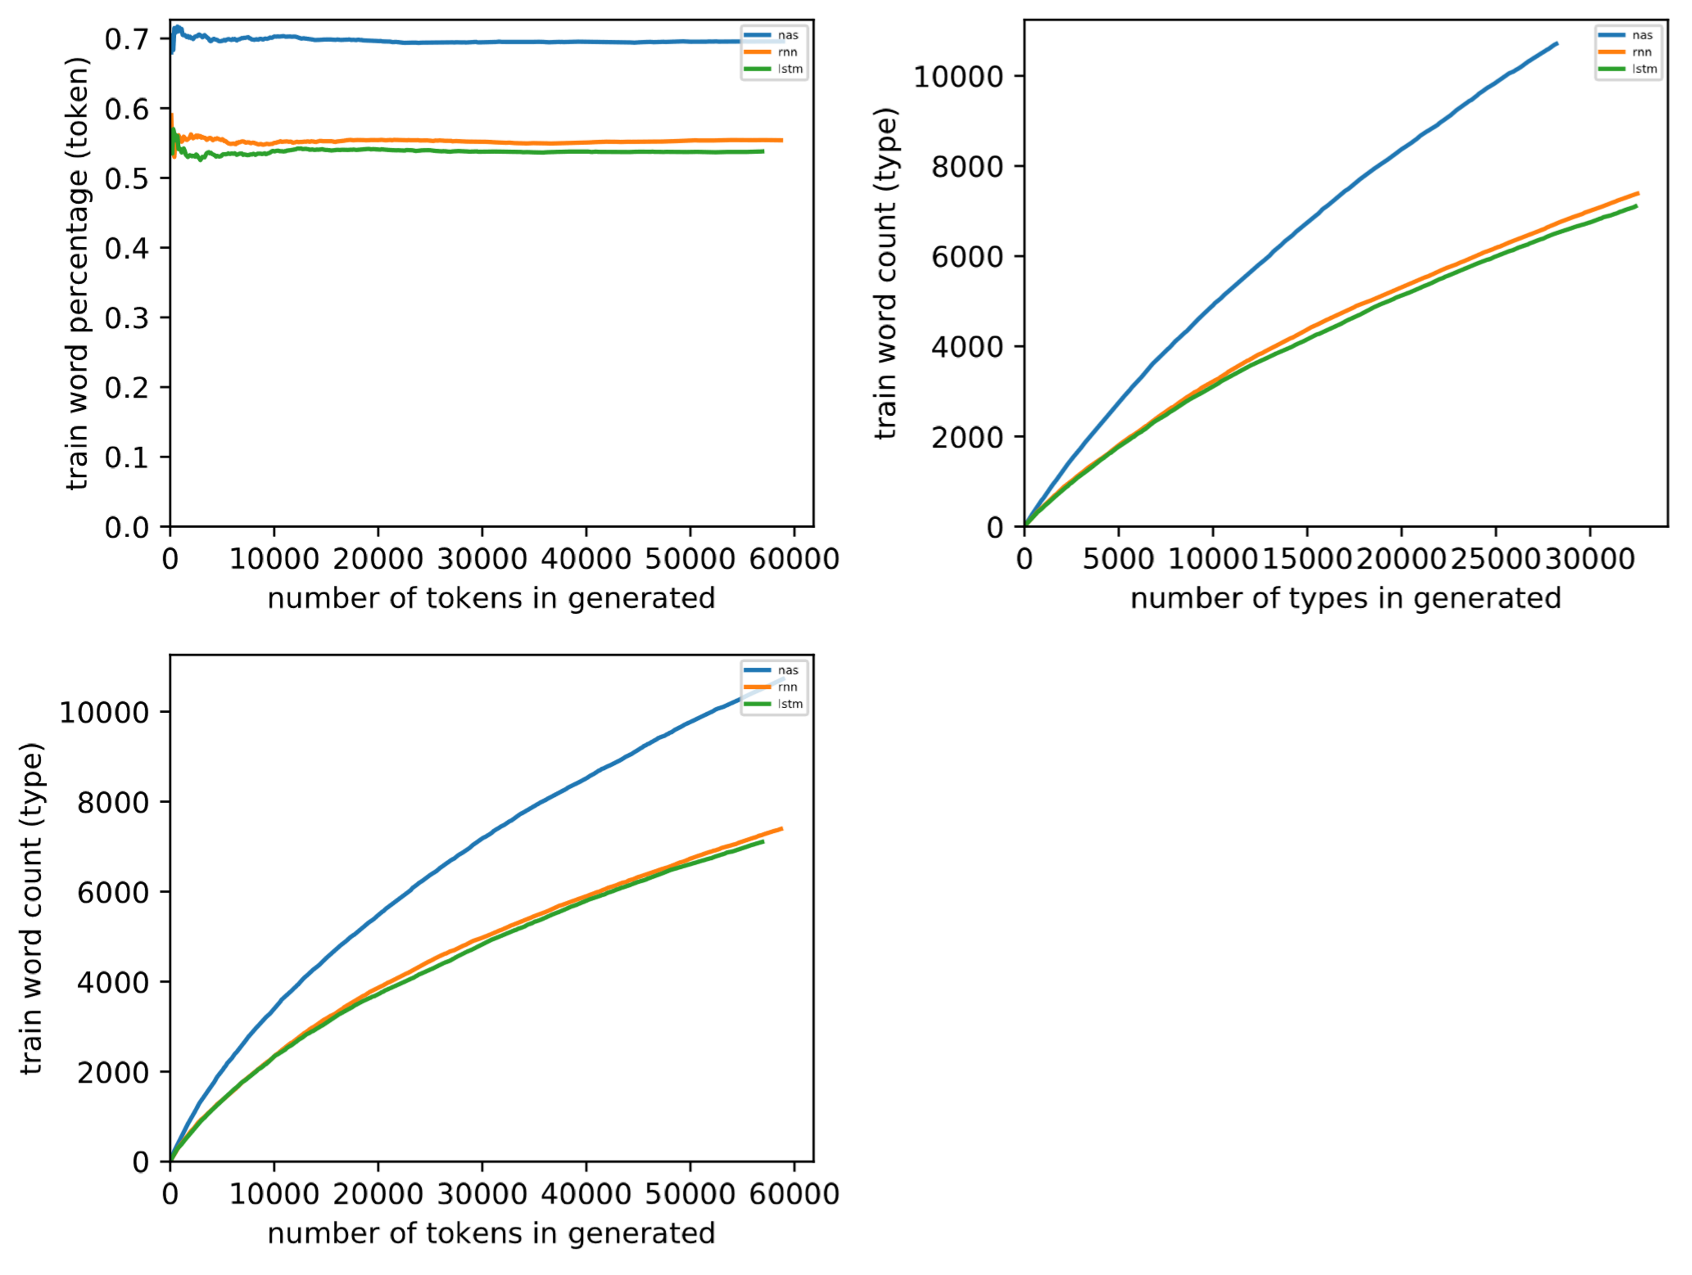
Finnish

Slide 19
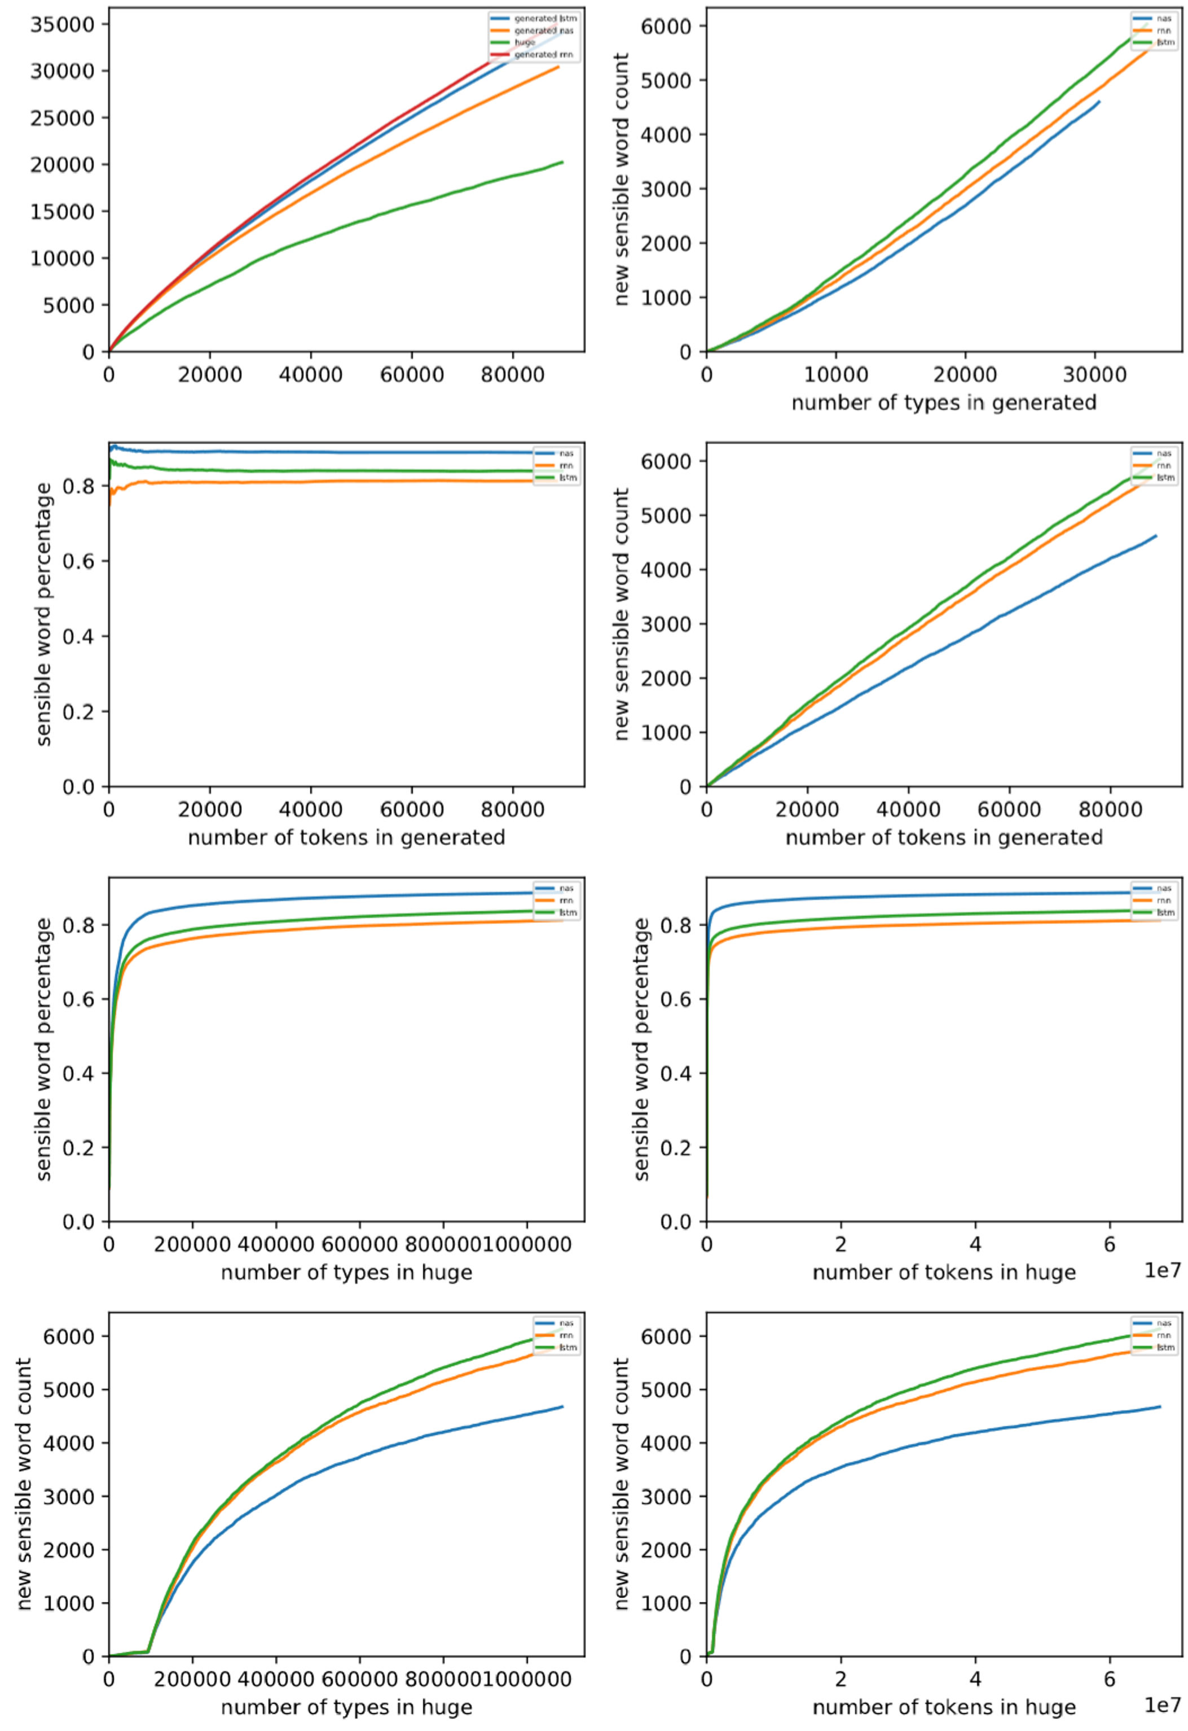
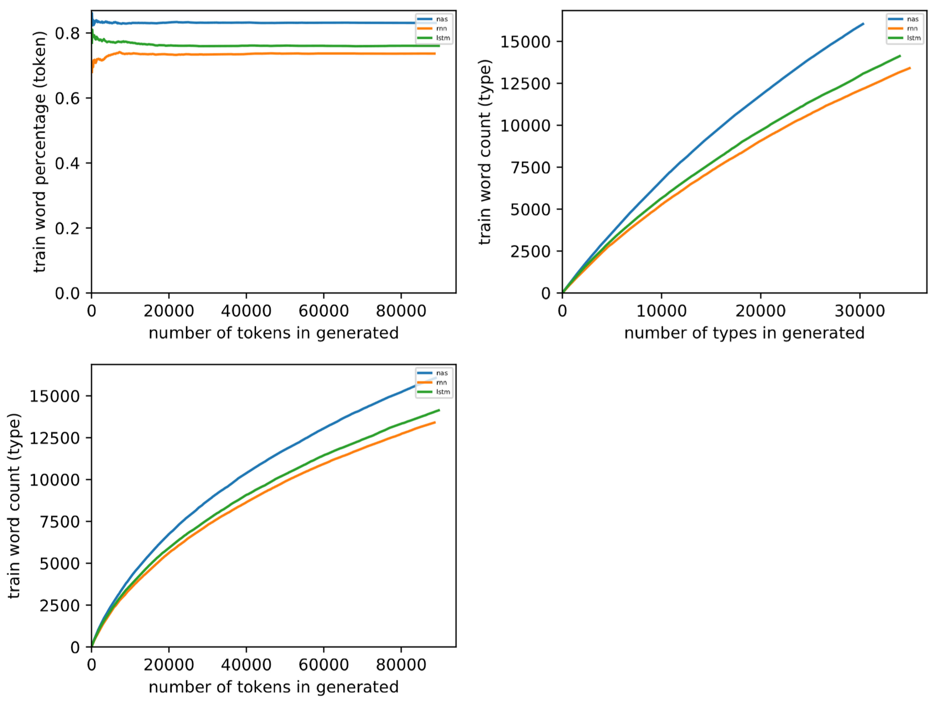
Hebrew

Slide 20
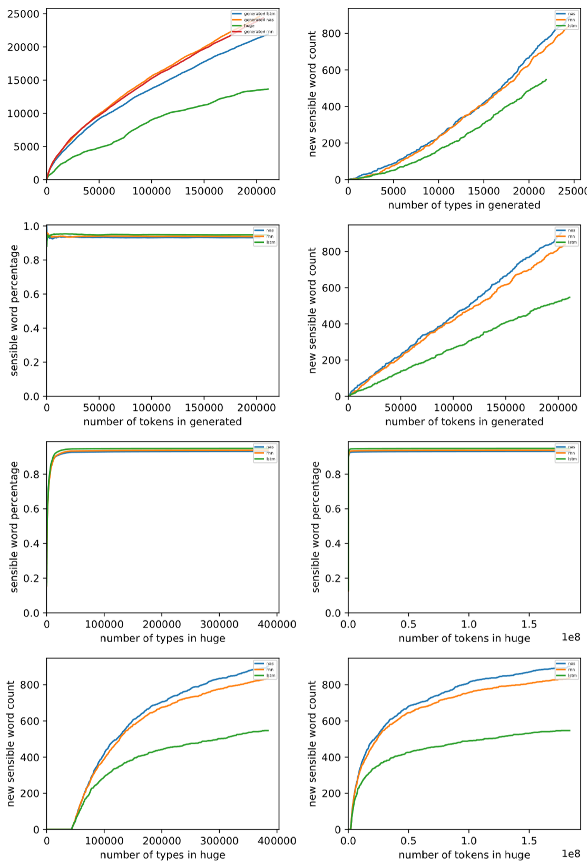
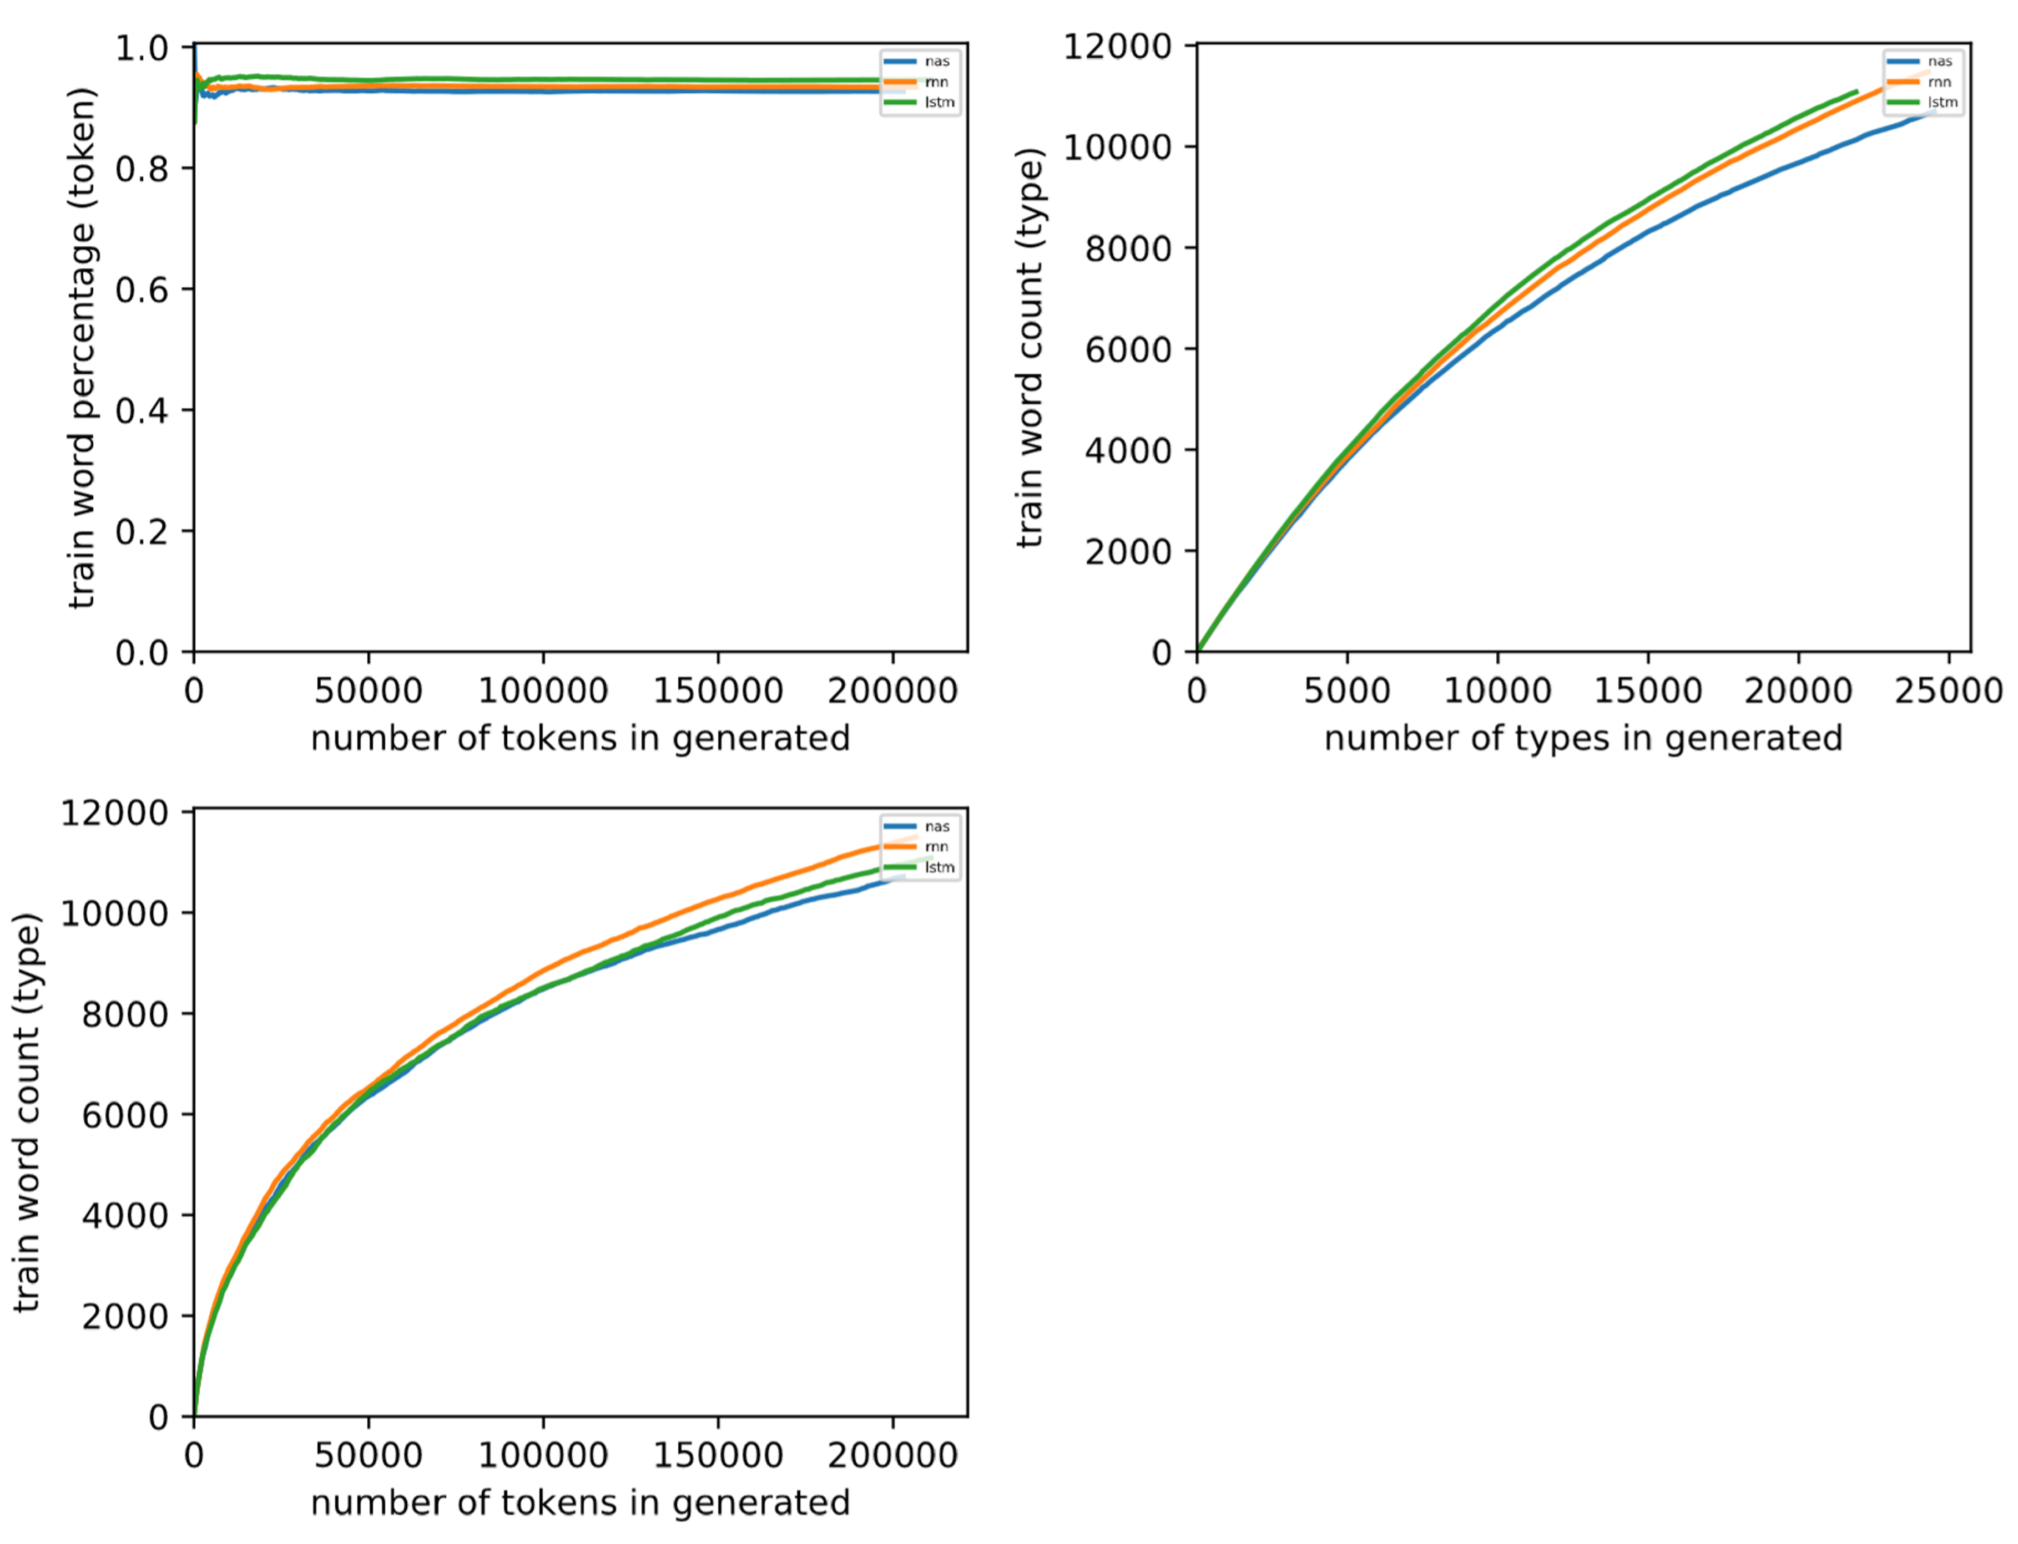
Chinese

Slide 21
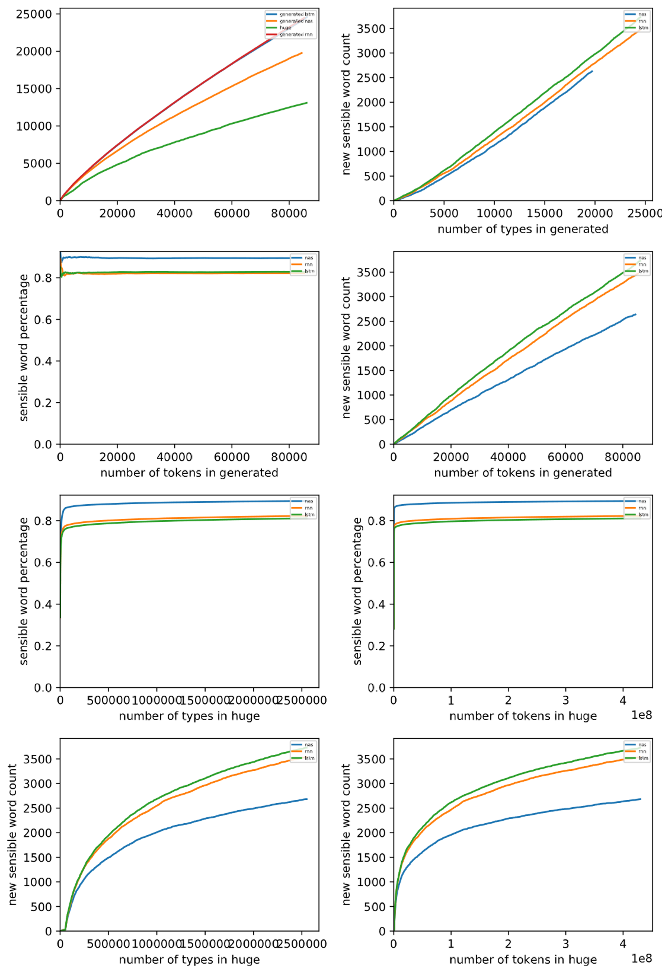
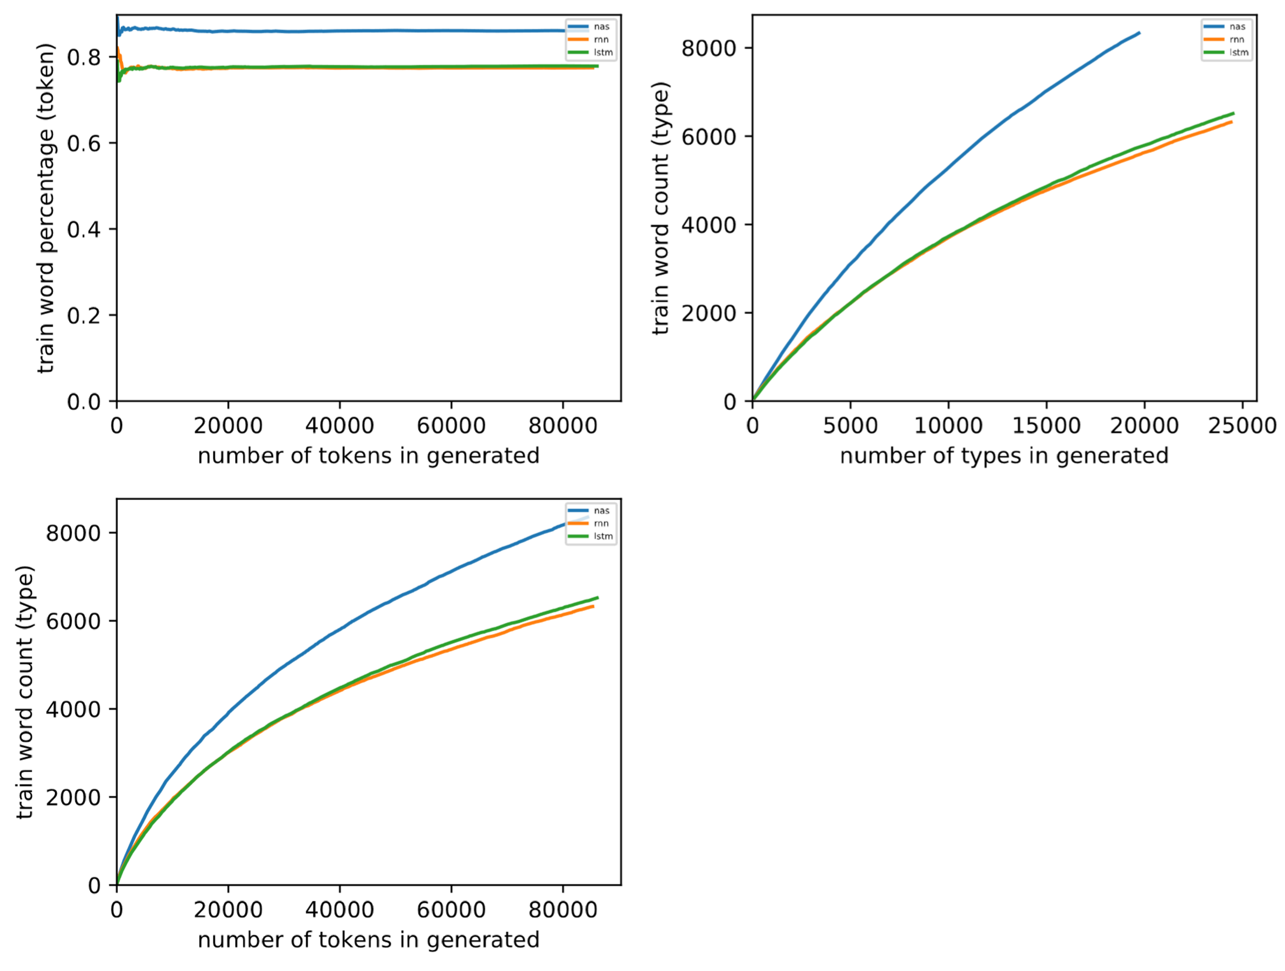
French

Slide 22
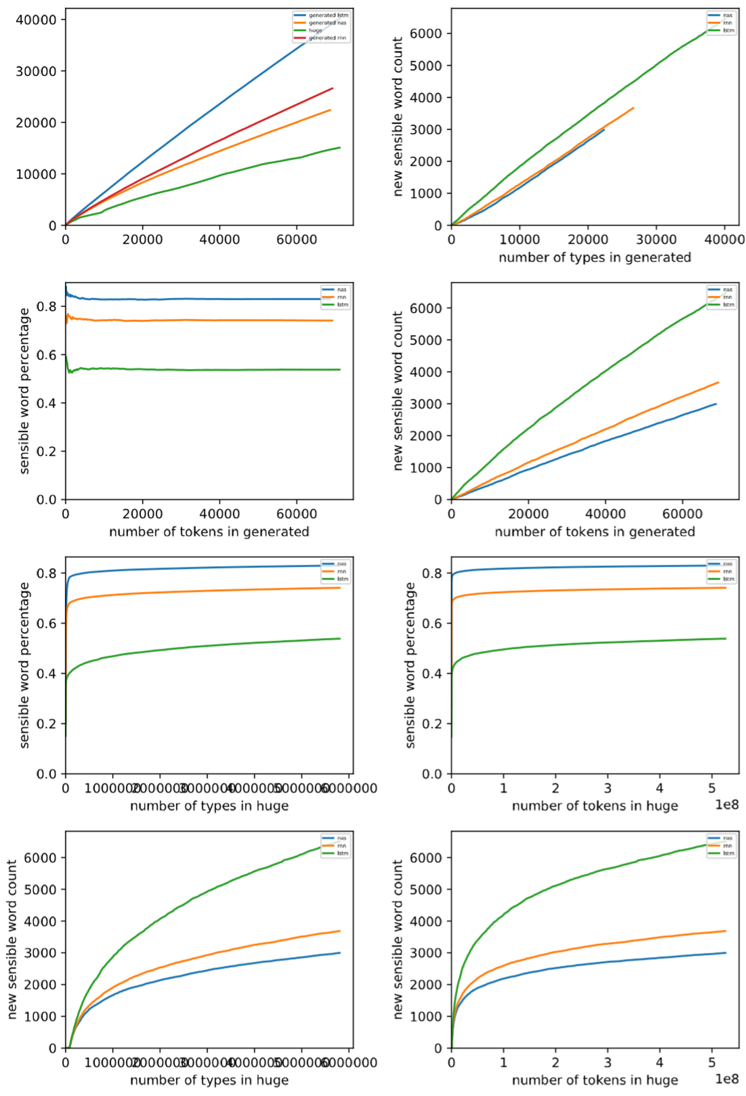
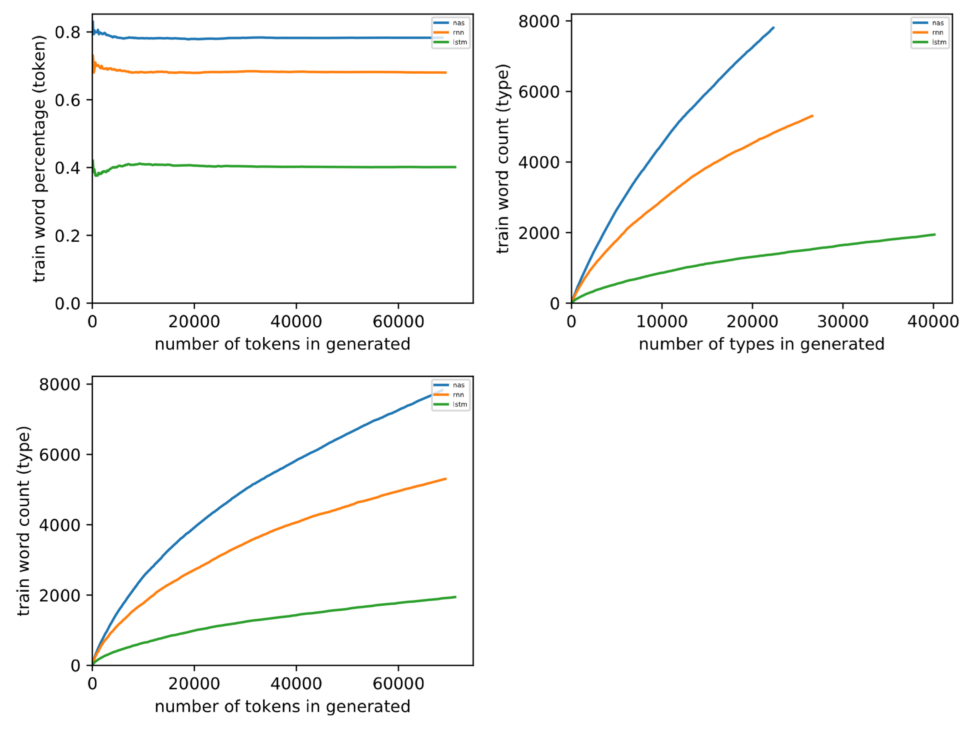
German

Slide 23
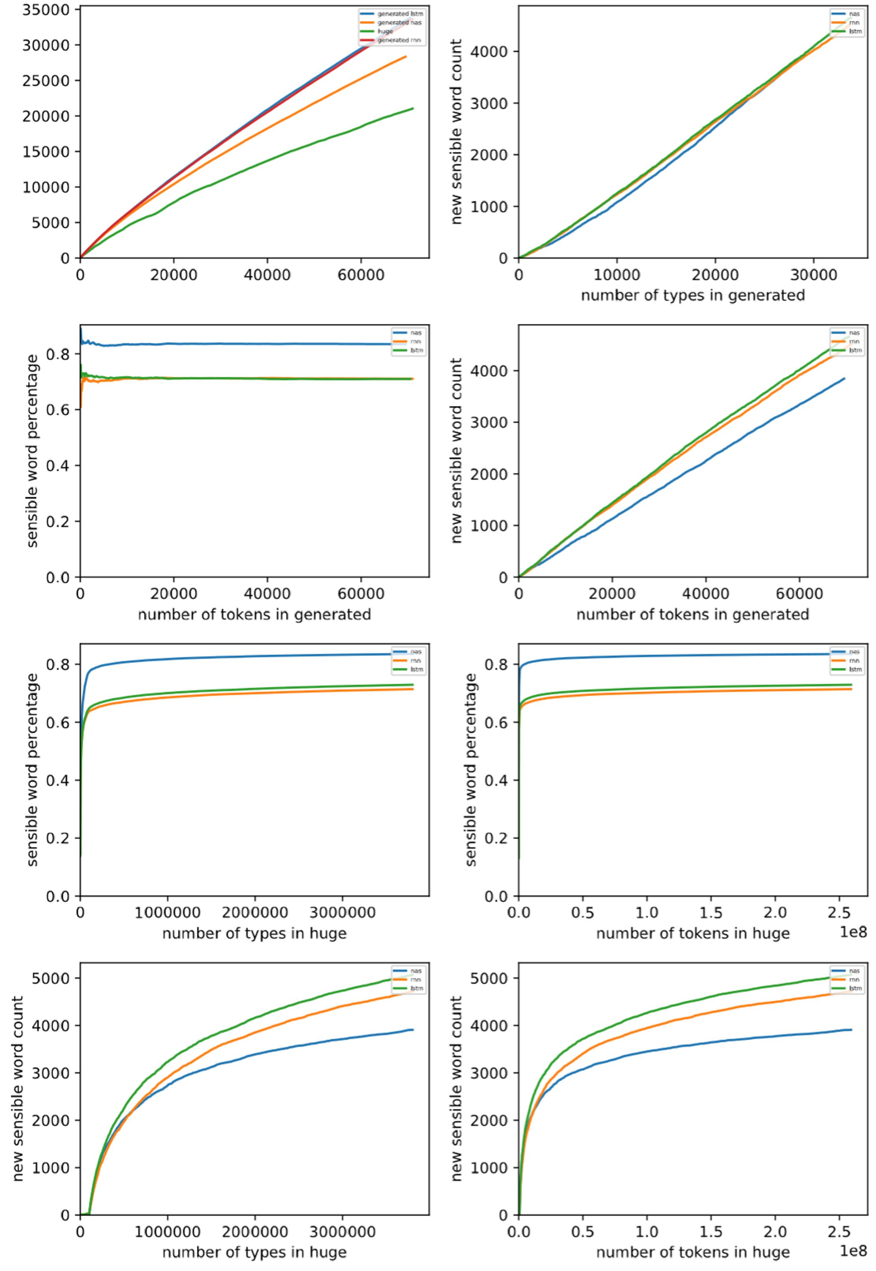
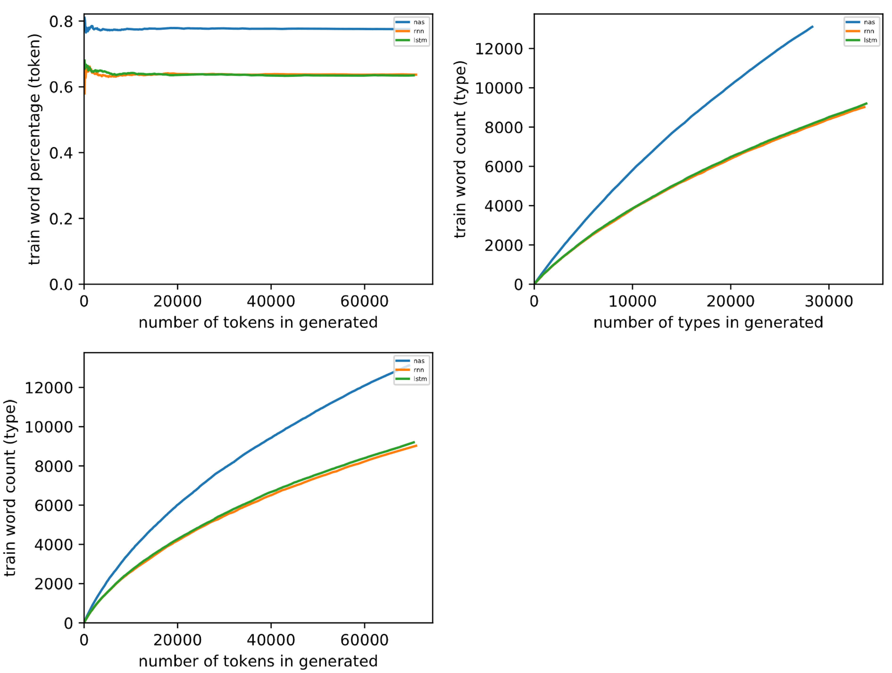
Russian

Slide 24
Plans
Consider the results for Gated Recurrent Units
Compute fair performance scores using Heap’s Law

Slide 25
Discussion

